Slide 1


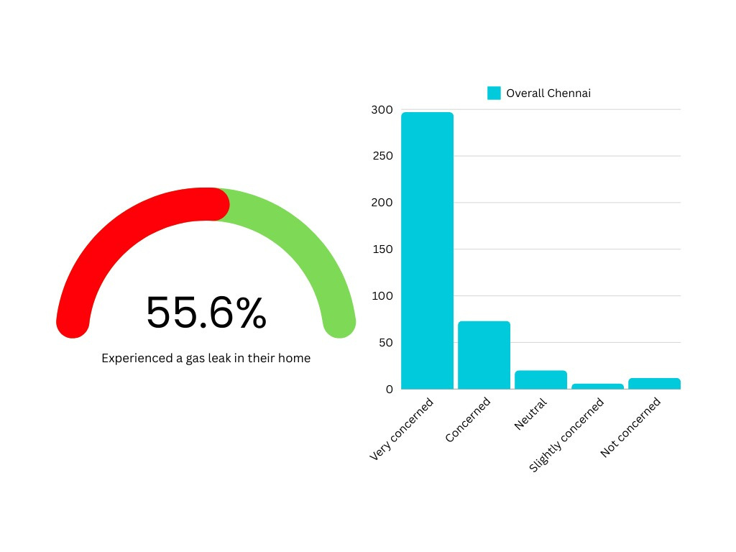
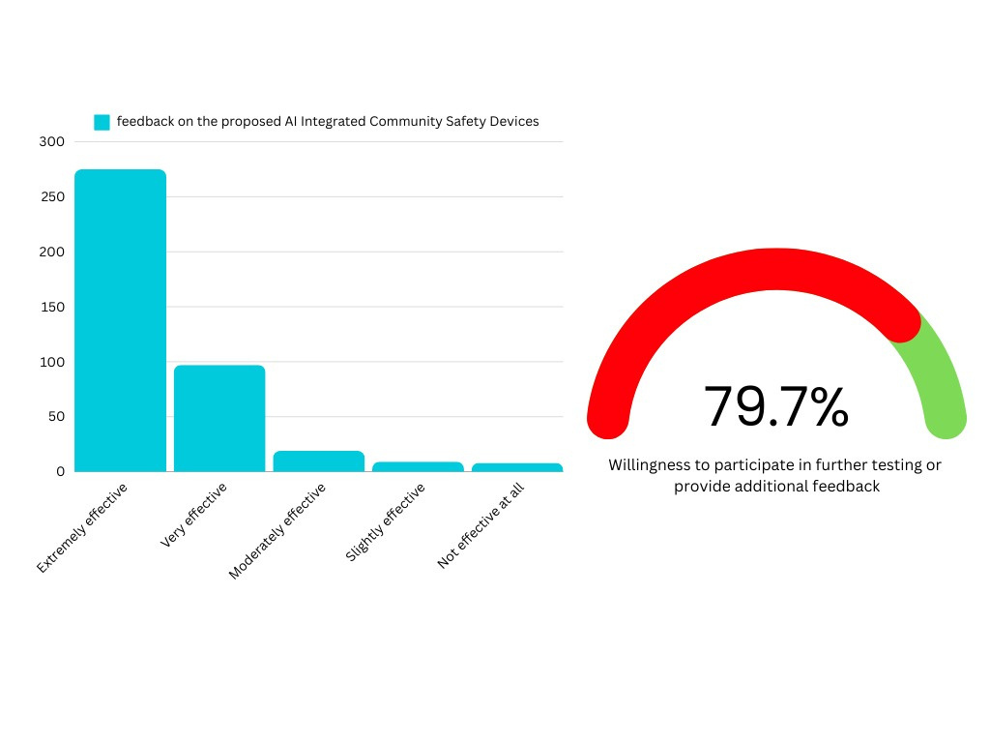
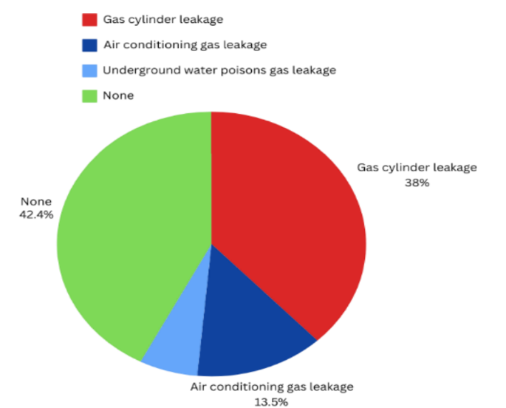
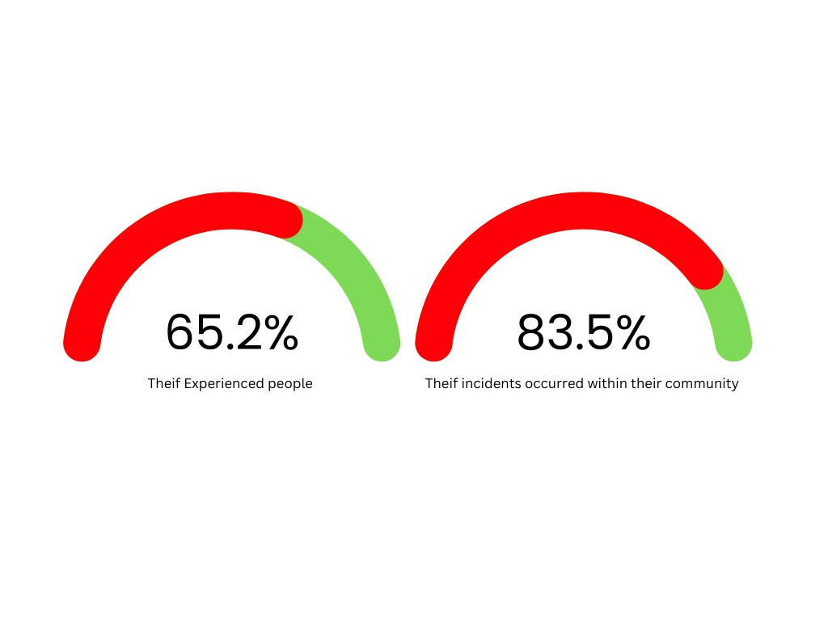
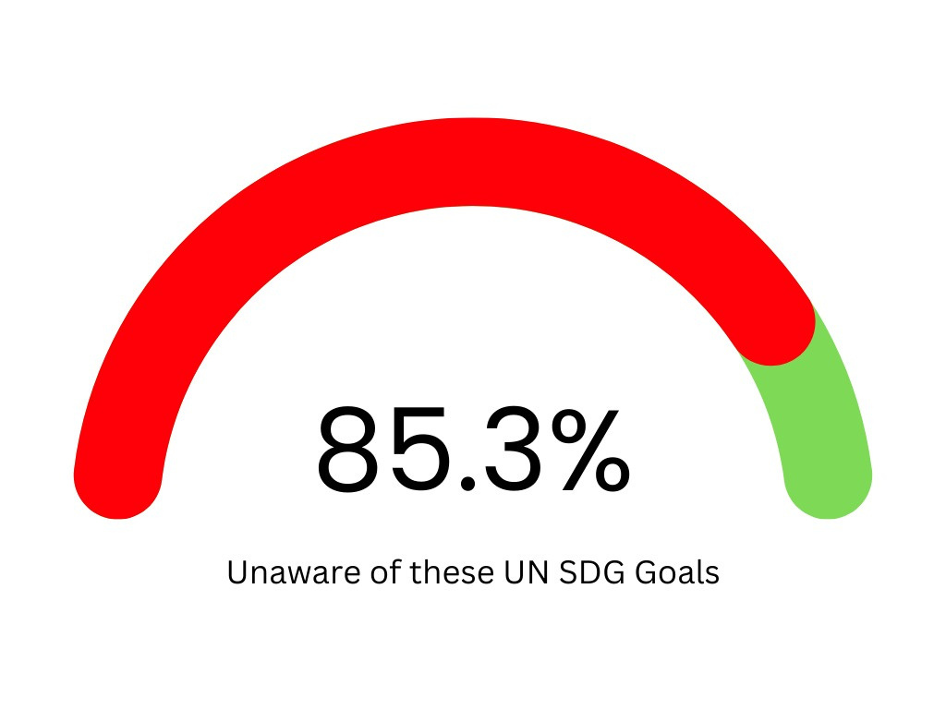
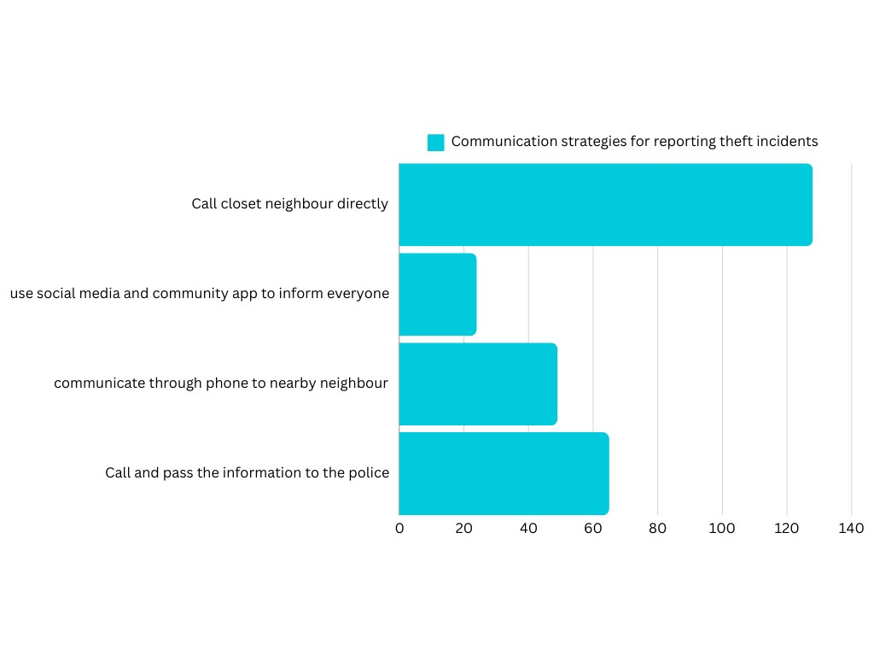
AI-Integrated Community Safety Solutions
Santhosh.R, Thanush.K, Pious Niranjan A
Department of CSE & CIVIL, Dr. M.G.R. Educational and Research Institute, Chennai, India
Abstract
Awareness and Concerns About Gas Leaks
Feedback on AI-CSD PROJECT
Rapid urbanization in Chennai has exposed gaps in traditional safety measures, limiting their effectiveness in dense settings.
This study explores AI-integrated solutions to address these challenges. A survey of 408 residents assessed safety perceptions, theft and gas leak experiences, awareness of SDGs (9, 11), and views on AI-enabled technologies. Results show varied safety perceptions, significant theft concerns, and moderate SDG awareness but limited understanding of AI's role.
Strong support exists for AI-driven innovations like smart alarms and sensors, highlighting their potential for real-time monitoring, proactive detection, and swift responses to enhance urban resilience.
55.6% experienced gas leaks at home.
Concern levels: 72.8% very concerned, 17.9% concerned, 2.9% not concerned.
Leak types: 38% cylinder leaks, 13.5% AC leaks, 6.1% underground leaks.
Highlights regional gas usage risks and need for targeted safety programs.
67.4% considered AI safety devices highly effective.
23.8% rated them very effective.
2.2% found them moderately effective.
2% considered them ineffective.
79.7% expressed interest in testing or providing feedback.
Highlights strong support for AI-based safety solutions.
Overview of Proposed System
Incidence of Theft Experiences
1. AI & IoT for Enhanced Safety
Integrates AI and IoT for real-time safety monitoring.
Detects theft, fire, gas leaks, and medical emergencies.
2. Smart Alert & Response System
Push-button or voice-activated emergency alerts.
Sensors for fire, gas leaks, and air quality monitoring.
Automatic alerts to neighbors and authorities.
3. Real-Time Wireless Communication
Operates on Wi-Fi (IEEE 802.11) and MQTT for instant notifications.
Blynk app integration for remote monitoring and alerts.
4. Smart Alarm & Notification Mechanism
Triggers alarms, solar-powered lights, and emergency messages.
OLED display for real-time hazard alerts.
Acknowledgment system to confirm emergency resolution.
5. Energy-Efficient & Secure Design
Runs on low-power ESP8266 with backup power options.
Uses secure MQTT communication for data protection.
6. Compliance with Safety Standards
IoT & AI integration: IEEE P2413
Fire safety: ISO/IEC 23894:2023, NFPA 72
Gas leak detection: UL 268
7. Contribution to Sustainable Development Goals
SDG 3 & SDG 11
65.2% of respondents reported being direct victims of theft or knowing someone affected, indicating a major safety issue in Chennai.
83.5% of theft incidents occurred outside homes, emphasizing the need for enhanced safety measures in public and communal areas.
Urban theft is a growing concern.
AI-based safety devices received positive feedback.
Awareness of SDGs
Respondents were largely unfamiliar with SDGs.
Highlights need for education on SDGs and their benefits.
Emphasizes SDGs' role in community safety and sustainability.
Lack of SDG awareness limits community engagement.
Promoting SDGs can enhance local safety and wellbeing.
Preferred Methods for Reporting Theft
Conclusions
48.1% preferred calling the nearest neighbor to report theft.
24.4% chose to call the police.
18.4% contacted neighbors via phone.
Only 9% used social media or community apps.
Highlights the need for timely, localized communication.
The proposed Home and Community Protection System represents a significant advancement in addressing emergency management and community safety. Based on a survey of 408 respondents, over 65.2% reported experiencing or knowing someone affected by theft, highlighting the need for improved security measures. Additionally, 55.6% of participants were concerned about gas leaks, a risk mitigated by the system’s AI-driven air quality monitoring and alert features. Positive feedback on the effectiveness of AI safety devices suggests strong future potential. The system aligns with Sustainable Development Goals (SDG 11), contributing to safer, more resilient urban communities. Future work will focus on enhancing the system’s design, scalability, and sensor capabilities.
Standards
References
A) ISO/IEC 23894:2023: International standard for AI system safety and risk management.
B) IEEE 802.11: Standard for wireless local area network (Wi-Fi) communication.
C) IEEE P2413: Architecture framework for the Internet of Things (IoT).
D) NFTA 72: Standard for fire alarm and signaling systems.
E) UL268: Standard for smoke detector testing and performance.
[1] A. Sherif, S. Sherif, C. P. Ooi, and W. H. Tan, "A LoRa- driven home security system for a residential community in a retirement township," International Journal of Technology, vol. 10, no. 7, pp. 1297-1306, 2019
[2] M. E. E. Alahi, A. Sukkuea, F. W. Tina, A. Nag, W. Kurdthongmee, K. Suwannarat, and S. C. Mukhopadhyay, "Integration of IoT-enabled technologies and artificial intelligence (AI) for smart city scenario: Recent advancements and future trends," Sensors, vol. 23, no. 11, p. 5206, May 2023 https://doi.org/10.3390/s23115206
[3] X. Li, R. Lu, X. Liang, X. (S.) Shen, J. Chen, and X. Lin, "Smart community: An Internet of Things application," IEEE Communications Magazine, vol. 49, no. 11, pp. 12-13, Nov. 2011. doi: https://10.1109/MCOM.2011.6069779
Contact
Thanush, Santhosh, Pious Niranjan, Dr. M.G.R. Educational and Research Institute ,Email: igenkthanush@gmail.com, Phone: 9791059466

Slide 2
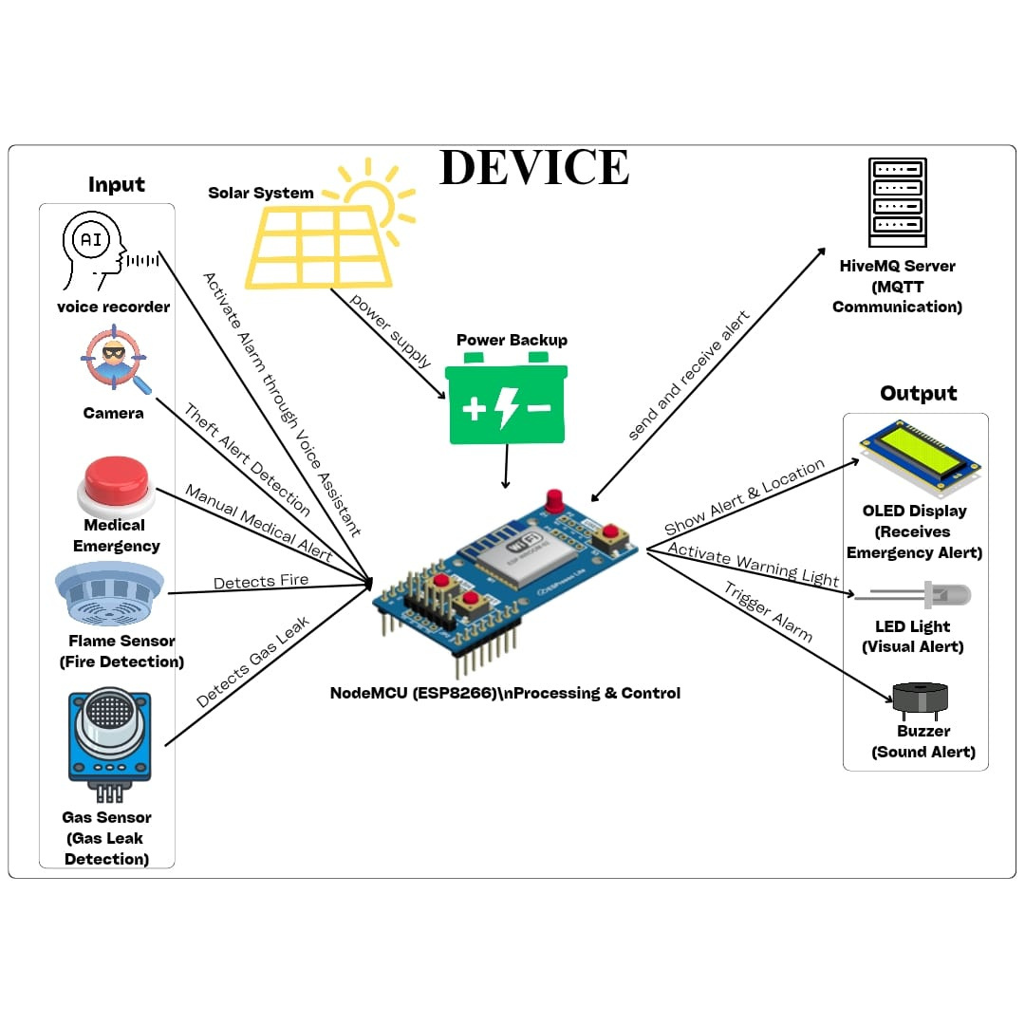
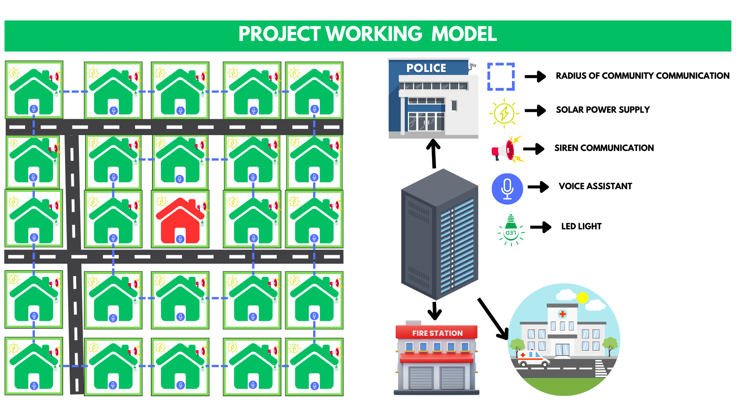
AI-Integrated Community Safety Solutions
Santhosh.R, Thanush.K, Pious Niranjan A
Department of CSE & CIVIL, Dr. M.G.R. Educational and Research Institute, Chennai, India
Prototype Architecture Diagram
Standards
References
A) ISO/IEC 23894:2023: International standard for AI system safety and risk management.
B) IEEE 802.11: Standard for wireless local area network (Wi-Fi) communication.
C) IEEE P2413: Architecture framework for the Internet of Things (IoT).
D) NFTA 72: Standard for fire alarm and signaling systems.
E) UL268: Standard for smoke detector testing and performance.
[1] A. Sherif, S. Sherif, C. P. Ooi, and W. H. Tan, "A LoRa- driven home security system for a residential community in a retirement township," International Journal of Technology, vol. 10, no. 7, pp. 1297-1306, 2019
[2] M. E. E. Alahi, A. Sukkuea, F. W. Tina, A. Nag, W. Kurdthongmee, K. Suwannarat, and S. C. Mukhopadhyay, "Integration of IoT-enabled technologies and artificial intelligence (AI) for smart city scenario: Recent advancements and future trends," Sensors, vol. 23, no. 11, p. 5206, May 2023 https://doi.org/10.3390/s23115206
[3] X. Li, R. Lu, X. Liang, X. (S.) Shen, J. Chen, and X. Lin, "Smart community: An Internet of Things application," IEEE Communications Magazine, vol. 49, no. 11, pp. 12-13, Nov. 2011. doi: https://10.1109/MCOM.2011.6069779
Contact
Thanush, Santhosh, Pious Niranjan, Dr. M.G.R. Educational and Research Institute ,Email: igenkthanush@gmail.com, Phone: 9791059466

